Slide 1
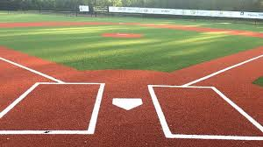
3D Scanned Baseball by Stephen Kwak, Bellarmine College Preparatory
2018 Summer Intern Project for Growshapes

